Slide 1

Geometry
Unit 9, Lesson 1a Area of a Polygon

Slide 2


Benchmarks
MA.912.GR.4.4
Solve mathematical and real-world problems involving the area of two-dimensional figures.

Slide 3
Integrated Mathematical Thinking and Reasoning Standards
MA.K12.MTR.4.1 Engage in discussions that reflect on the mathematical thinking of self and others.
MA.K12.MTR.5.1 Use patterns and structure to help understand and connect mathematical concepts.

Slide 4

Learning Target
I can solve mathematical and real-world problems involving the area of a polygon.

Slide 5

Warm-Up

Slide 6
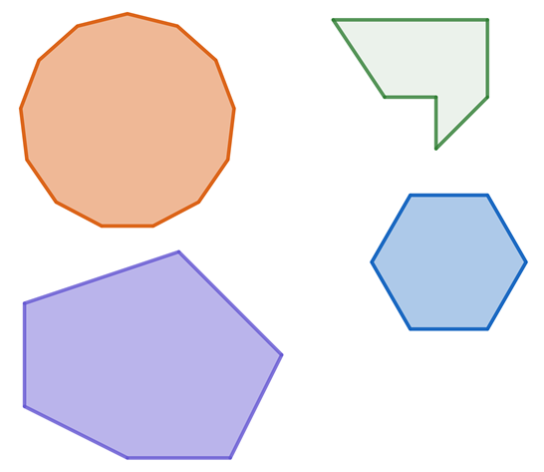
9.1a.1 Warm-Up: Which One Doesn’t Belong?
Four different polygons are shown.
Which polygon does not belong?
What characteristic did you use to make your decision?

Slide 7

Collaboration

Slide 8

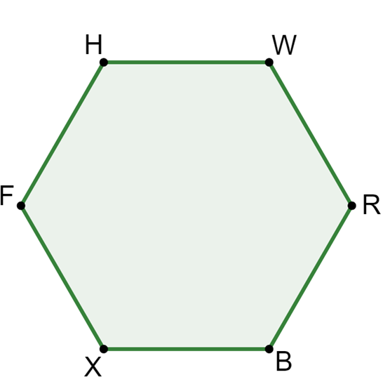
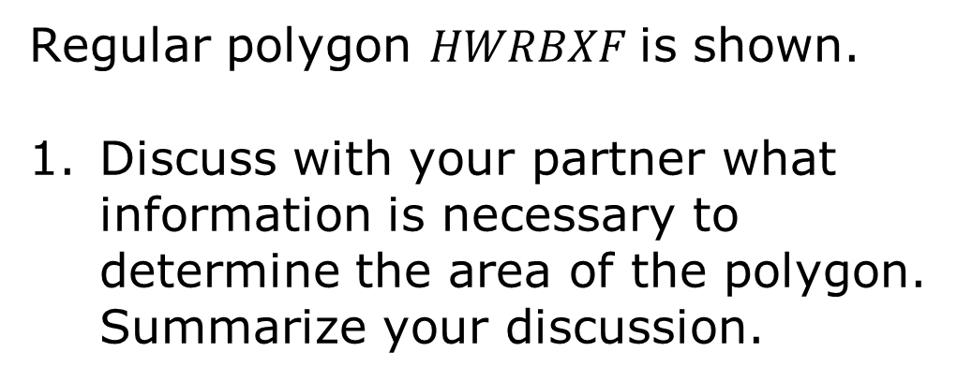
9.1a.2 Collaboration: Decomposing a Regular Polygon
Regular polygon $HWRBXF$is shown.
Discuss with your partner what information is necessary to determine the area of the polygon. Summarize your discussion.

Slide 9
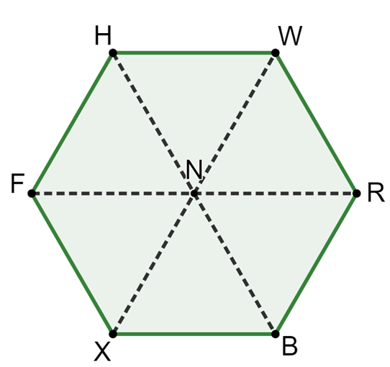
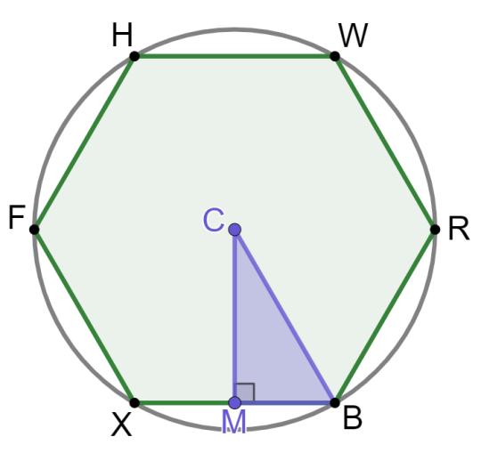
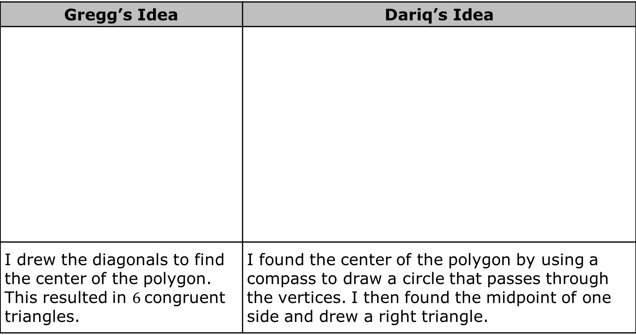
Gregg and Dariq shared their ideas with their class.
Gregg’s Idea | Dariq’s Idea
I drew the diagonals to find the center of the polygon. This resulted in $6$congruent triangles. | I found the center of the polygon by using a compass to draw a circle that passes through the vertices. I then found the midpoint of one side and drew a right triangle.

Slide 10
Determine what, if any, further information Gregg needs to determine the area of the polygon.
Determine what, if any, further information Dariq needs to determine the area of the polygon.

Slide 11
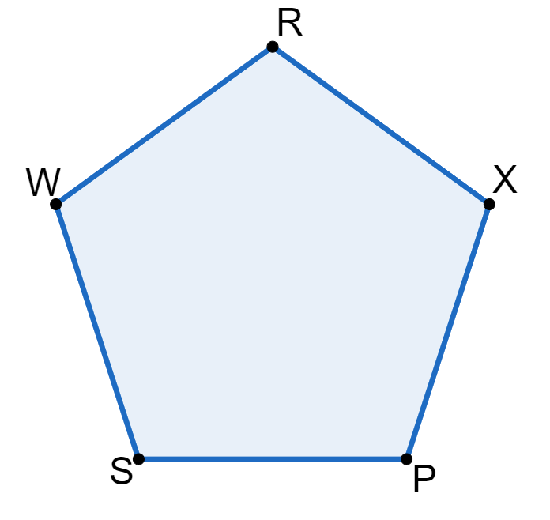
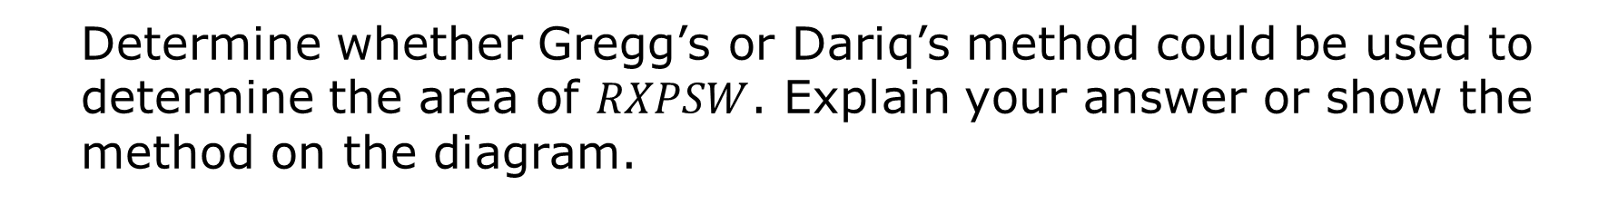
Regular polygon $RXPSW$is shown.
Determine whether Gregg’s or Dariq’s method could be used to determine the area of $RXPSW$. Explain your answer or show the method on the diagram.

Slide 12

Exploration

Slide 13


9.1a.3 Exploration: Regular Polygons
Regular Polygon
A polygon that is both equilateral (all sides congruent) and equiangular (all angles congruent).
Polygons $HWRBXF$ and $RXPSW$ are both regular polygons. The diagram shows the center of each polygon and the midpoint of one side.

Slide 14
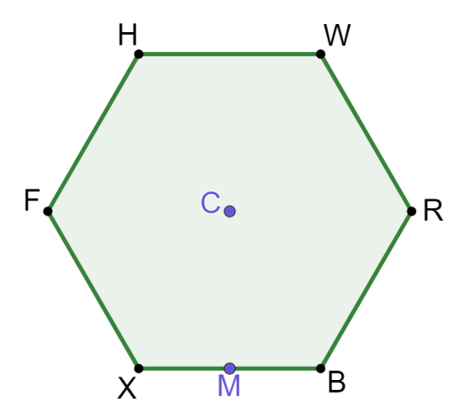
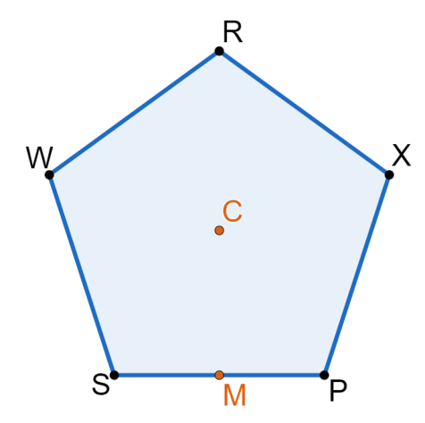
In polygon $HWRBXF$, draw $∆XCB$, and in polygon $RXPSW$, draw $∆SCP$.

Slide 15



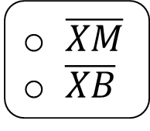
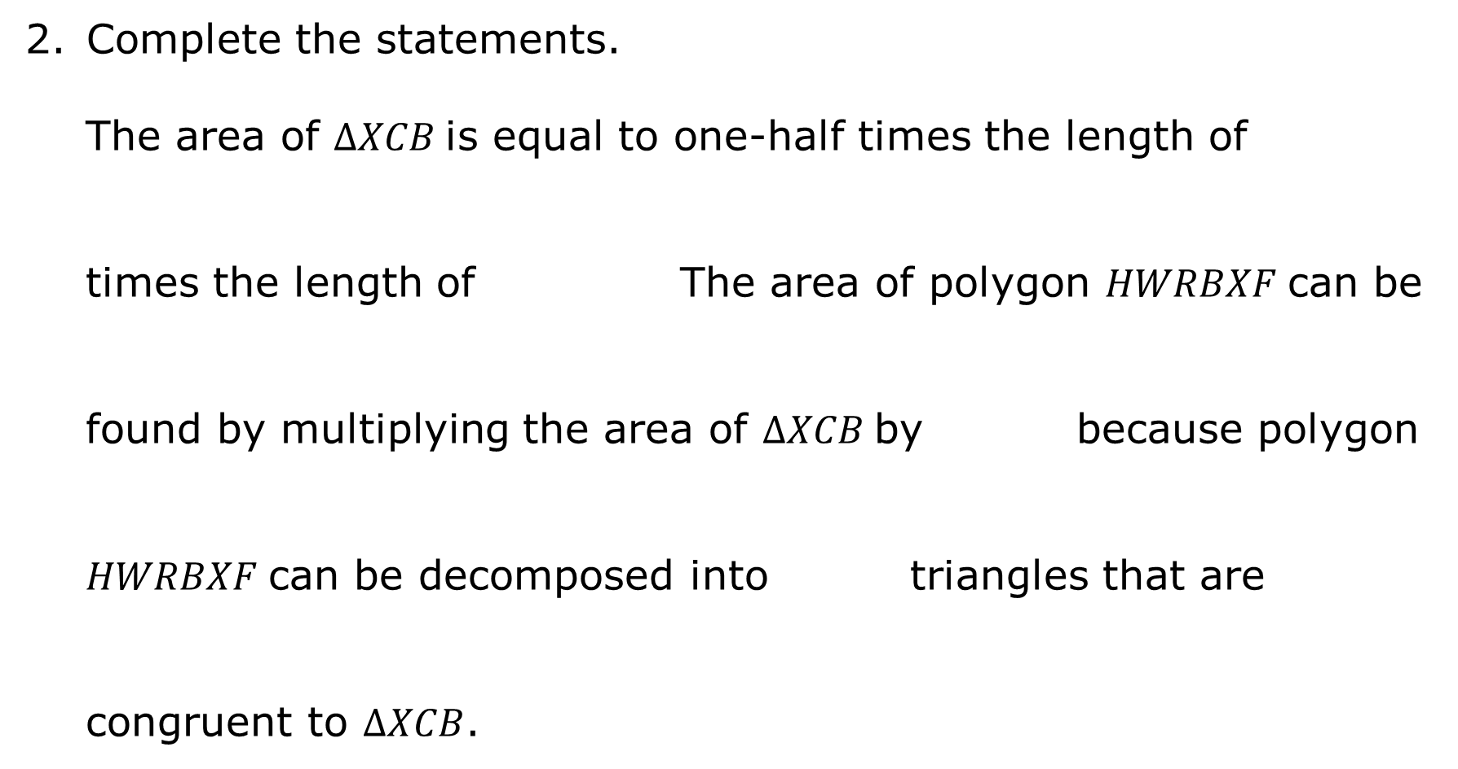
Complete the statements.
The area of $∆XCB$is equal to one-half times the length of
times the length of The area of polygon $HWRBXF$can be
found by multiplying the area of $∆XCB$by because polygon
$HWRBXF$can be decomposed into triangles that are
congruent to $∆XCB$.
$\overline{XM}$
$\overline{XB}$
$\overline{CM}$.
$\overline{CX}$.
$4$
$5$
$6$
$7$
$4$
$5$
$6$
$7$

Slide 16



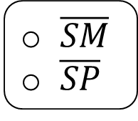
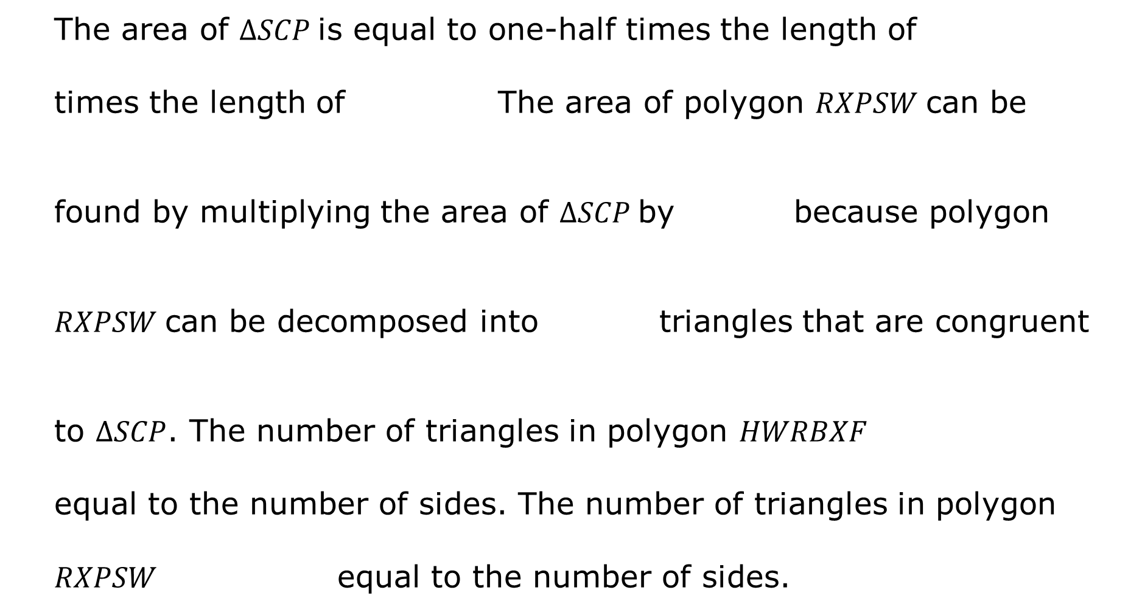
$\overline{SM}$
$\overline{SP}$
The area of $∆SCP$is equal to one-half times the length of
times the length of The area of polygon $RXPSW$can be
found by multiplying the area of $∆SCP$by because polygon
$RXPSW$can be decomposed into triangles that are congruent
to $∆SCP$. The number of triangles in polygon $HWRBXF$
equal to the number of sides. The number of triangles in polygon
$RXPSW$ equal to the number of sides.
$\overline{CM}$.
$\overline{CS}$.
$4$
$5$
$6$
$7$
$4$
$5$
$6$
$7$
is
is not
is
is not

Slide 17

Guided Instruction

Slide 18
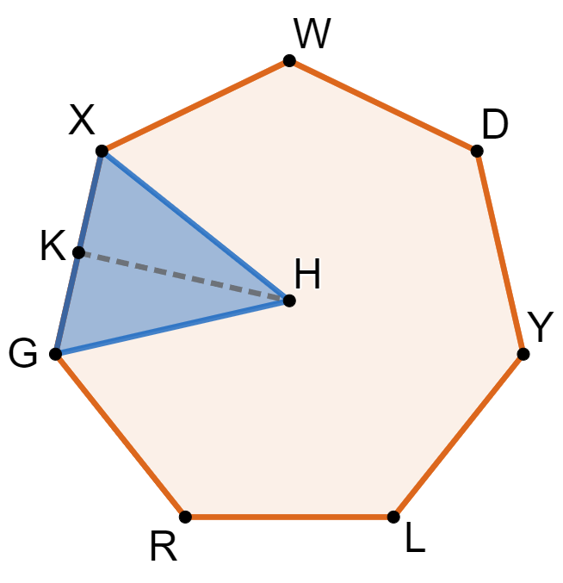
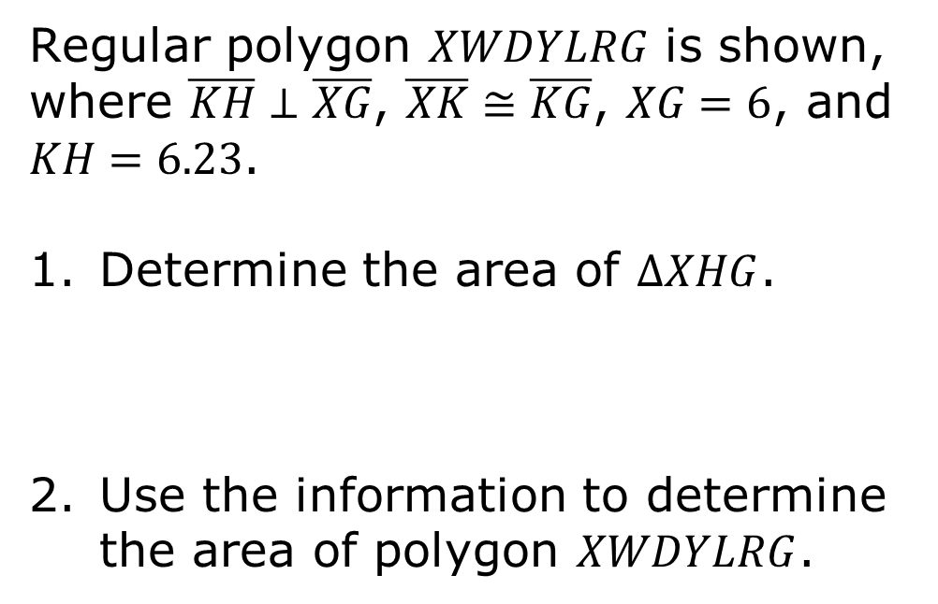
9.1a.4 Guided Instruction: Area of a Regular Polygon
Regular polygon $XWDYLRG$ is shown, where $\overline{KH}⊥\overline{XG}$, $\overline{XK}≅\overline{KG}$, $XG=6$, and $KH=6.23$.
Determine the area of $∆XHG$.
Use the information to determine the area of polygon $XWDYLRG$.

Slide 19
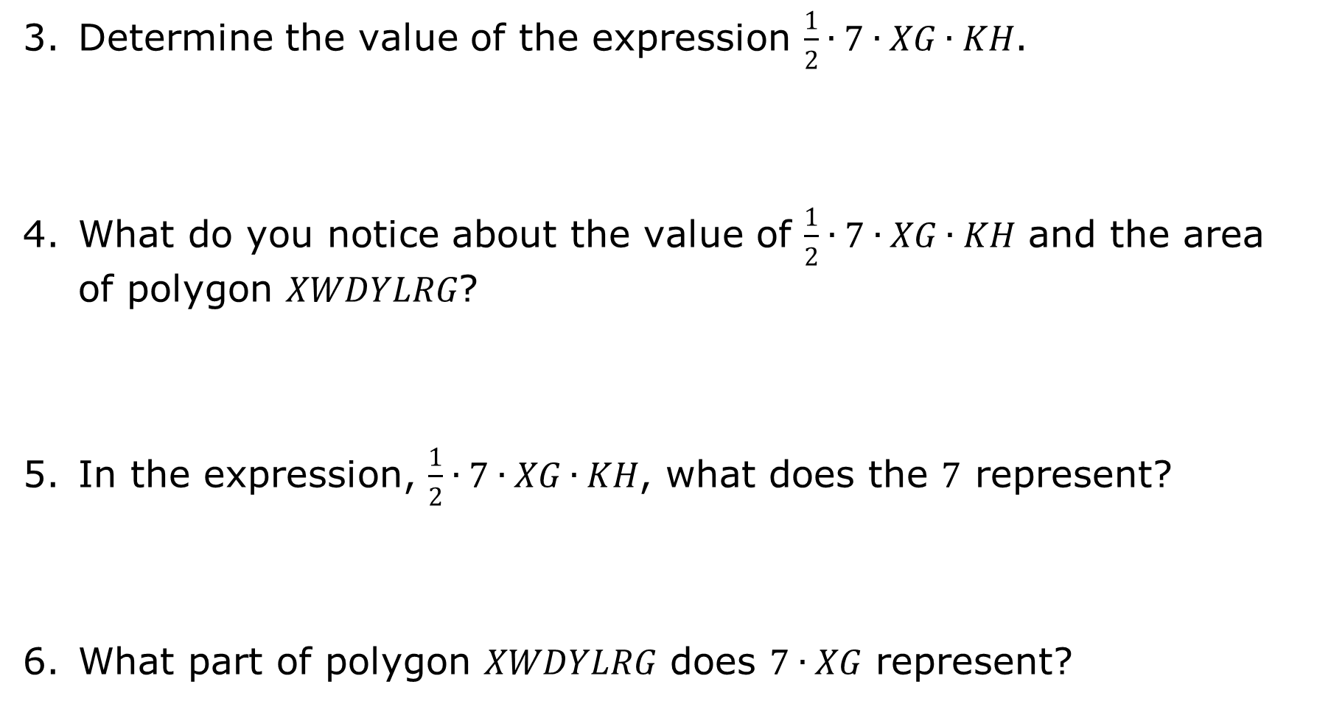
Determine the value of the expression $\frac{1}{2}∙7∙XG∙KH$.
What do you notice about the value of $\frac{1}{2}∙7∙XG∙KH$ and the area of polygon $XWDYLRG$?
In the expression, $\frac{1}{2}∙7∙XG∙KH$, what does the $7$ represent?
What part of polygon $XWDYLRG$ does $7∙XG$ represent?

Slide 20
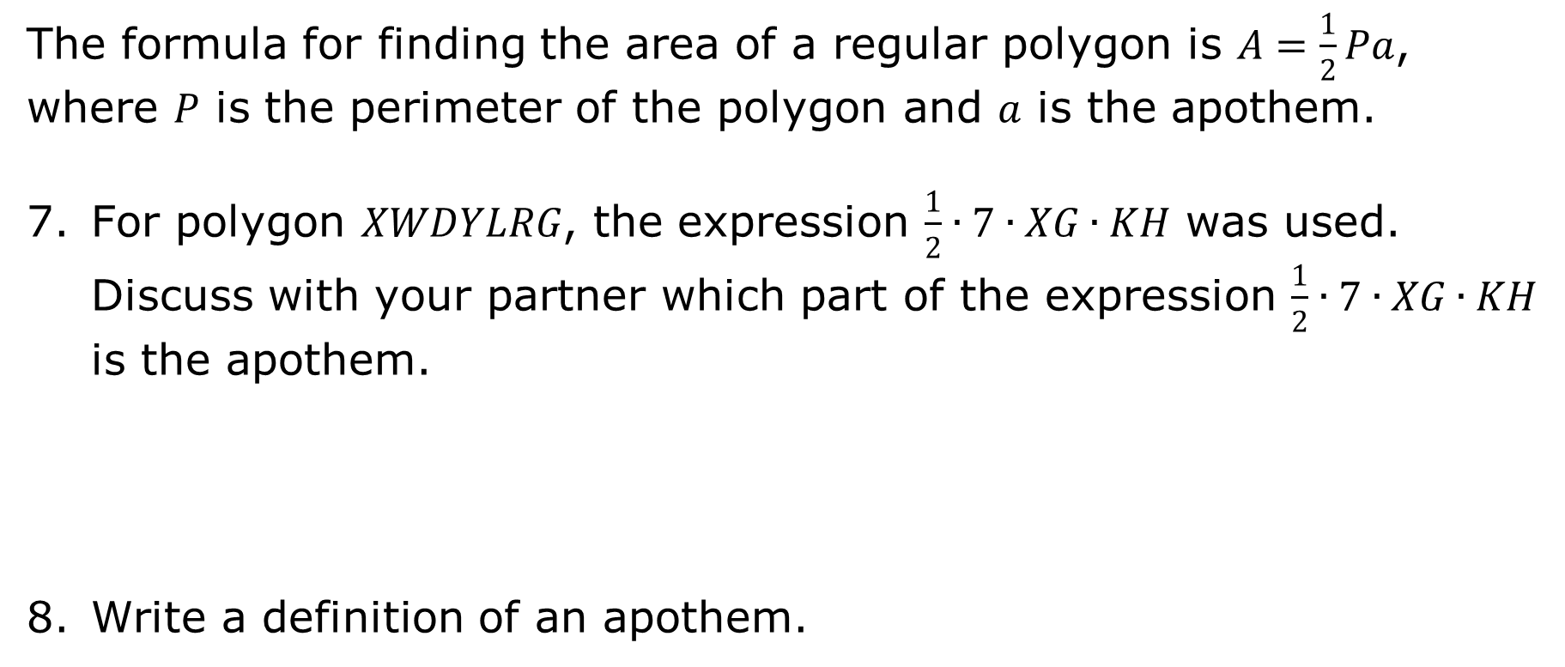
The formula for finding the area of a regular polygon is $A=\frac{1}{2}Pa$, where $P$ is the perimeter of the polygon and $a$ is the apothem.
For polygon $XWDYLRG$, the expression $\frac{1}{2}∙7∙XG∙KH$ was used. Discuss with your partner which part of the expression $\frac{1}{2}∙7∙XG∙KH$ is the apothem.
Write a definition of an apothem.

Slide 21
Share your definition of an apothem with a classmate by stating the definition to each other. Record your classmate’s definition as they state it. You are the only person who should write in the first two columns of the table. Have the person initial next to their definition stating that your written definition is correct.
Class definition of apothem.
Classmate | Definition of apothem | Initials

Slide 22

Guided Practice

Slide 23

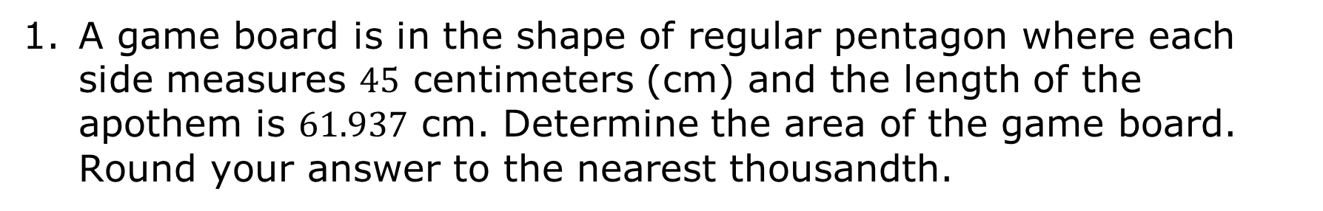
9.1a.5 Guided Practice: Determining Area of a Polygon
A game board is in the shape of regular pentagon where each side measures $45$ centimeters (cm) and the length of the apothem is $61.937$ cm. Determine the area of the game board. Round your answer to the nearest thousandth.
volume 2, pg. 295

Slide 24
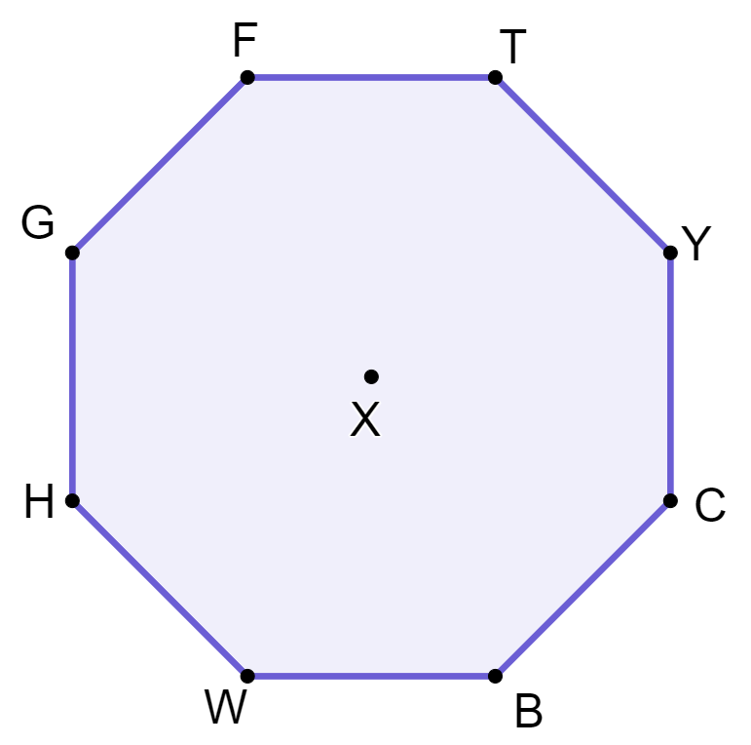
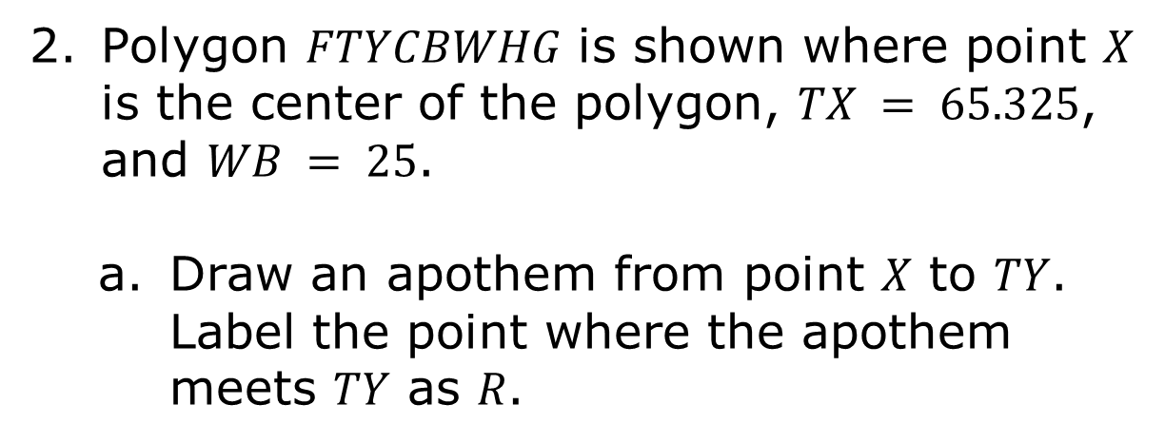
Polygon $FTYCBWHG$ is shown where point $X$ is the center of the polygon, $TX = 65.325$, and $WB = 25$.
Draw an apothem from point $X$ to $TY$. Label the point where the apothem meets $TY$ as $R$.

Slide 25
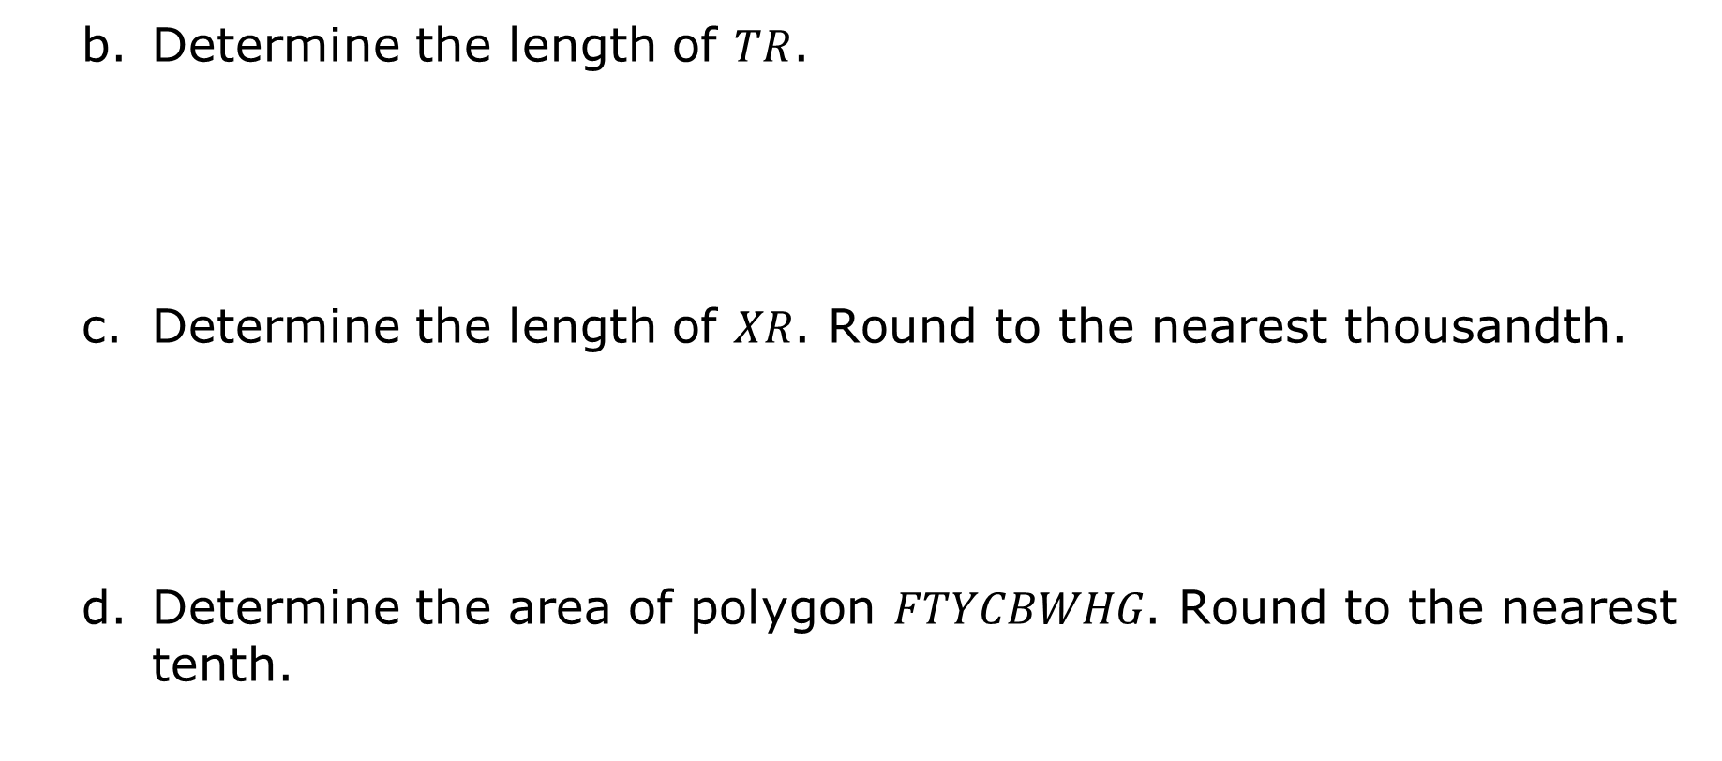
Determine the length of $TR$.
Determine the length of $XR$. Round to the nearest thousandth.
Determine the area of polygon $FTYCBWHG$. Round to the nearest tenth.

Slide 26

Your Turn

Slide 27
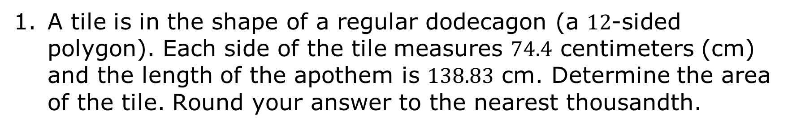
9.1a.6 Your Turn!
A tile is in the shape of a regular dodecagon (a $12$-sided polygon). Each side of the tile measures $74.4$ centimeters (cm) and the length of the apothem is $138.83$ cm. Determine the area of the tile. Round your answer to the nearest thousandth.

Slide 28
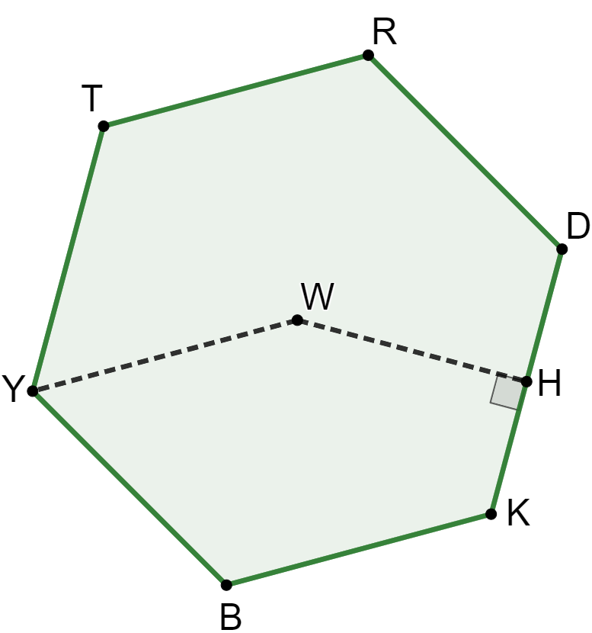
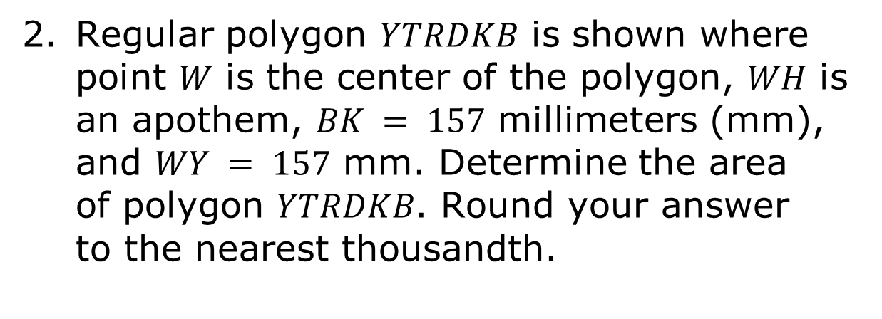
Regular polygon $YTRDKB$ is shown where point $W$ is the center of the polygon, $WH$ is an apothem, $BK = 157$ millimeters (mm), and $WY = 157$ mm. Determine the area of polygon $YTRDKB$. Round your answer to the nearest thousandth.

Slide 29

Wrap-Up

Slide 30
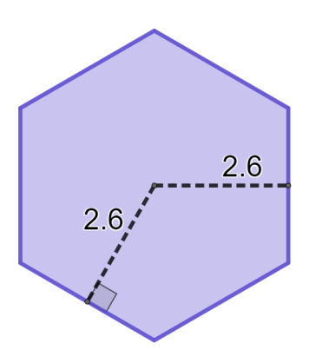
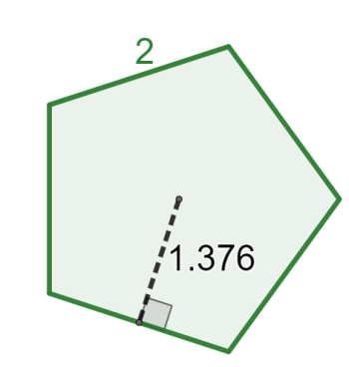
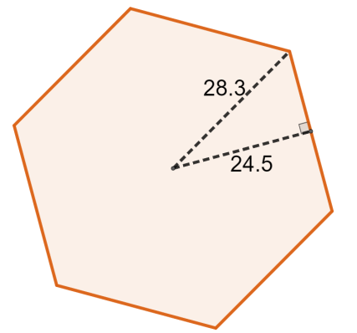
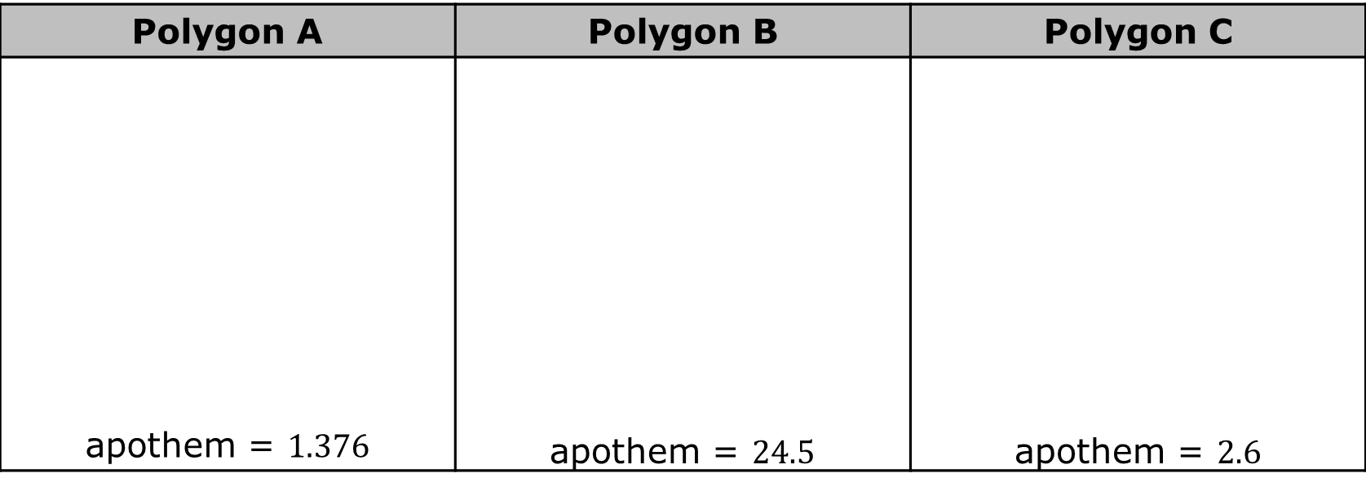
9.1a.7 Wrap-Up: Enough Information?
Six regular polygons are shown with measurements.
Polygon A | Polygon B | Polygon C
apothem = $1.376$ | apothem = $24.5$ | apothem = $2.6$

Slide 31
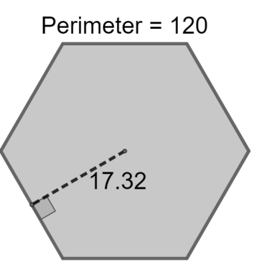
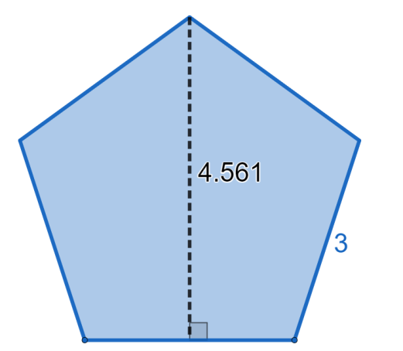
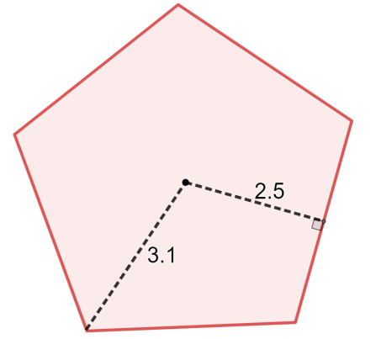
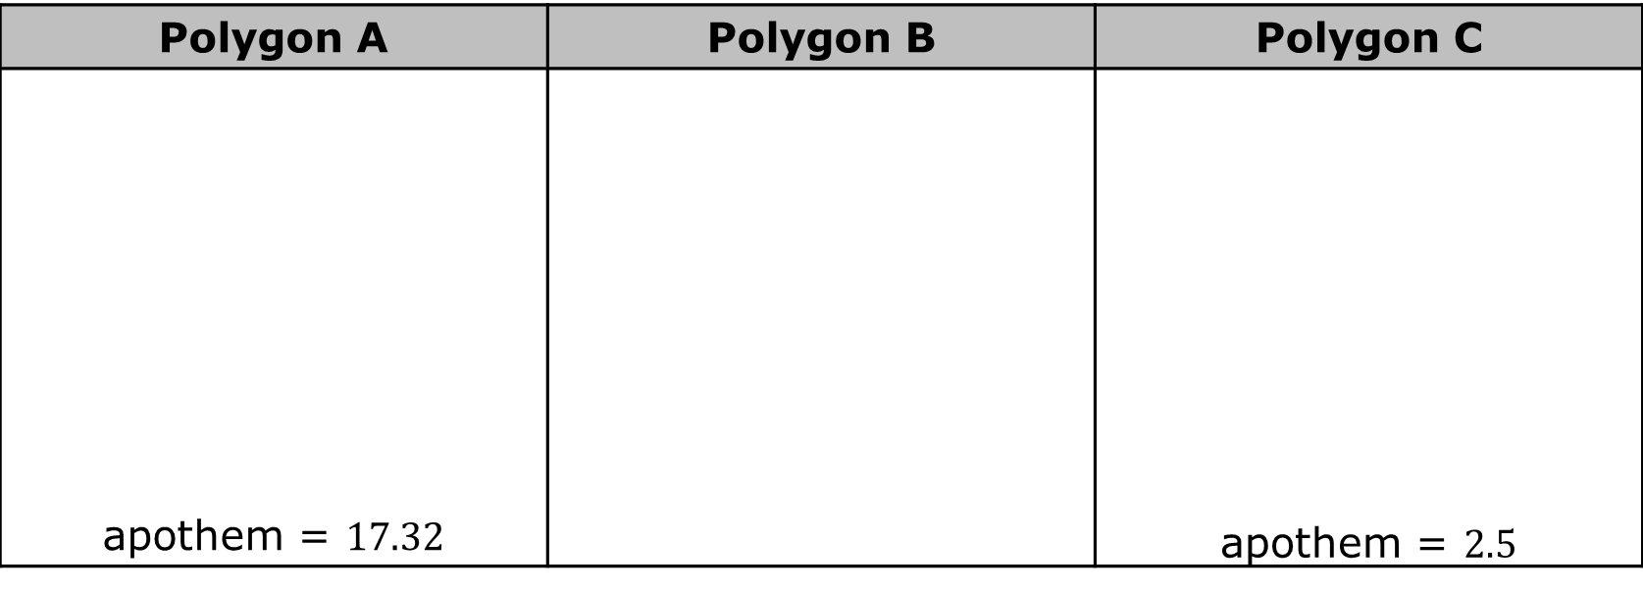
Polygon A | Polygon B | Polygon C
apothem = $17.32$ |  | apothem = $2.5$
Select all of the regular polygons which have enough information to determine the area of the polygon.
Polygon A Polygon B Polygon C | Polygon D Polygon E Polygon F

